Slide 1
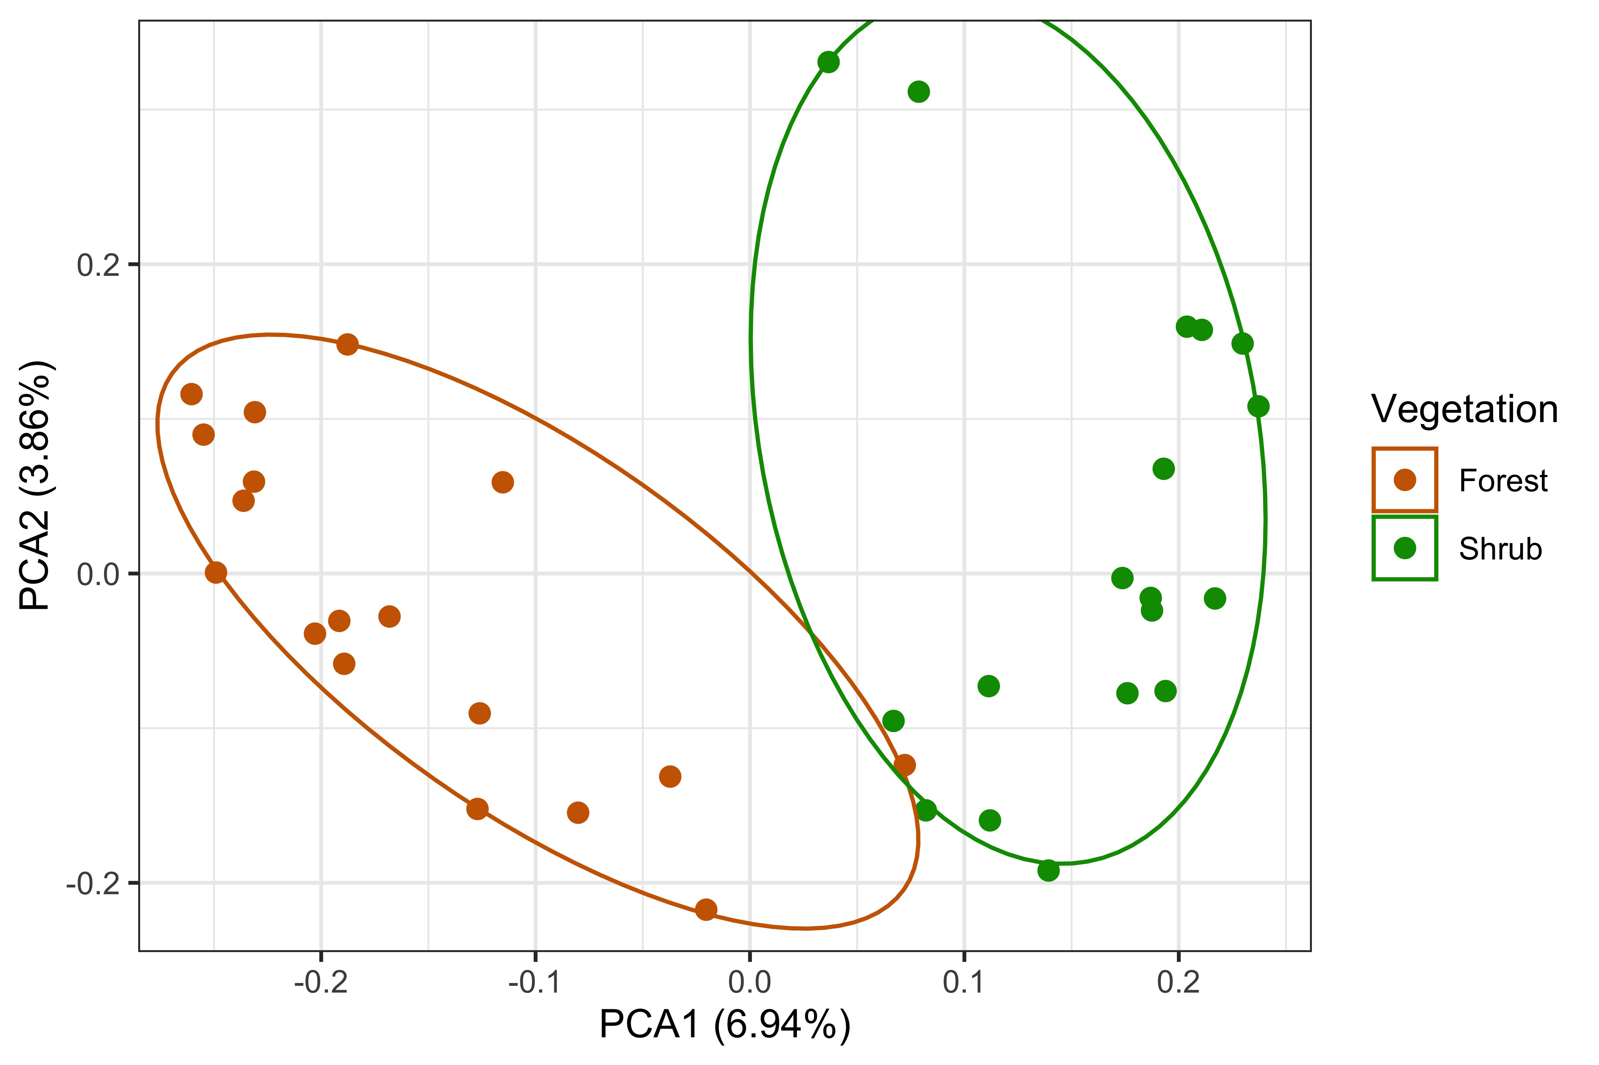
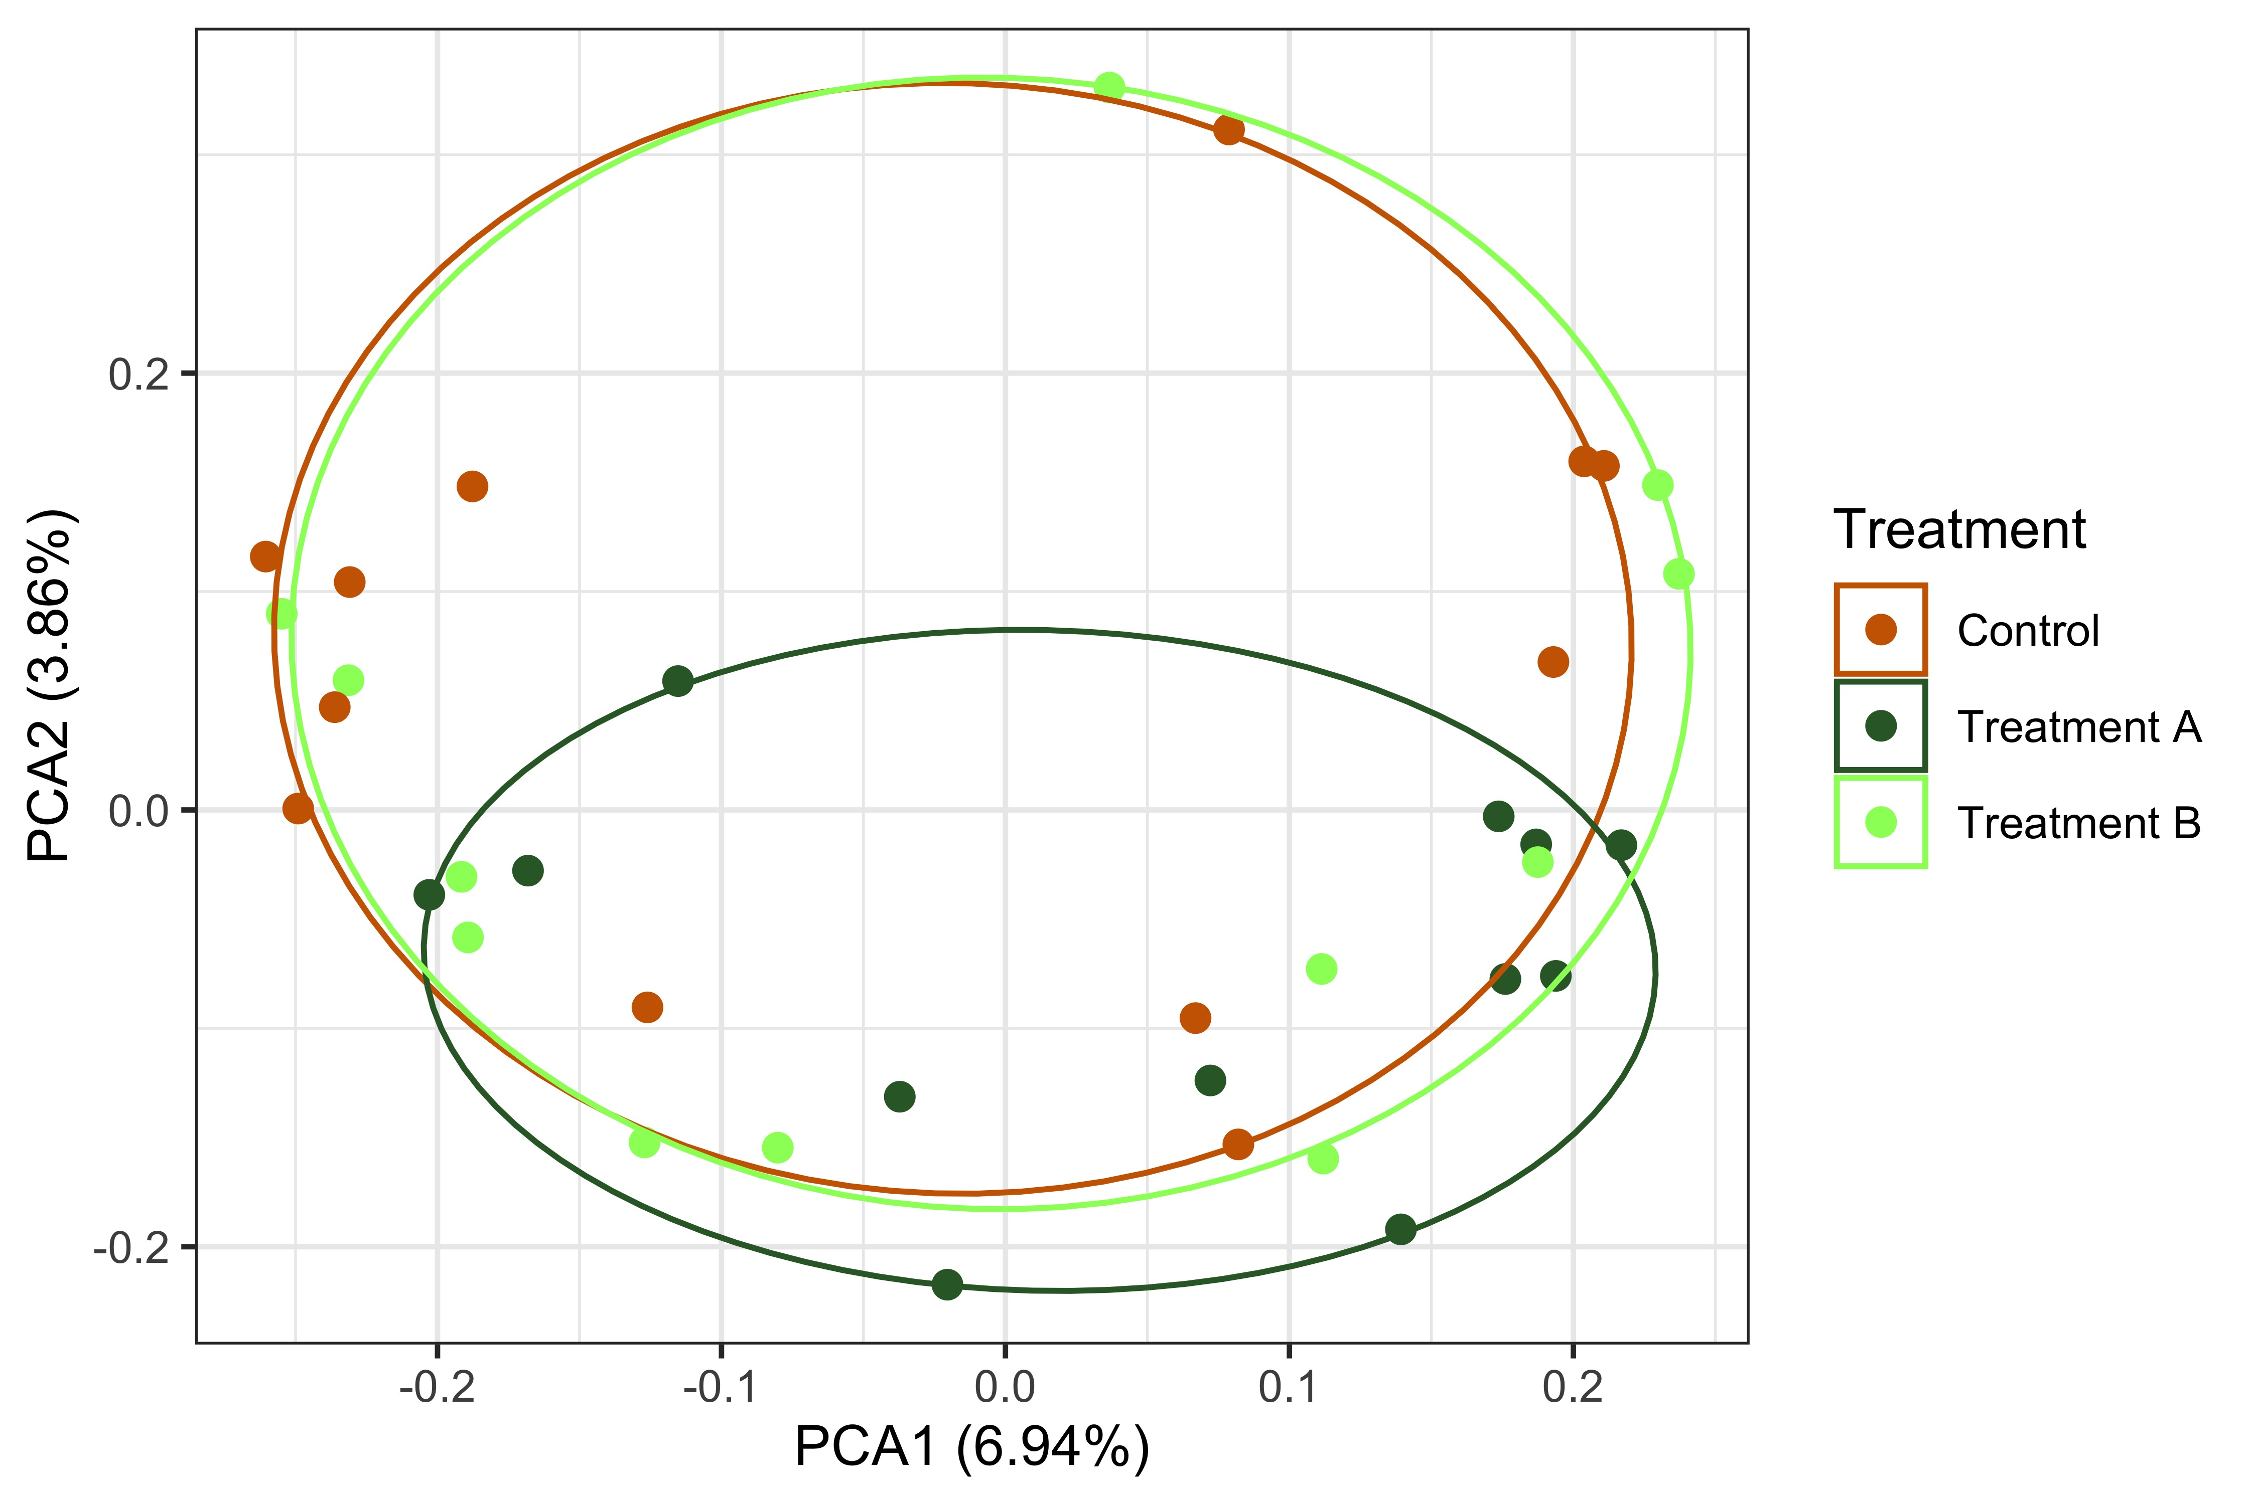
Bacterial communities of Quintos vary by vegetation but not by grazing treatment.

